Slide 1
RequestDispatcher Interface:-
javax.servlet.RequestDispatcher interface is used to receive a client request and can do one of the following two things -
1- It can forward client request to some other servlet, jsp or html file.
2- It can include some other file (servlet, jsp or html) into currently executing file (servlet or jsp, which contain the RequestDispatcher).
It has the following two methods -
1- public void forward(ServletRequest request, ServletResponse response)throws ServletException,IOException - This method is used to forward client request to some other servlet, jsp or html file specified by RequestDispatcher.
2- public void include(ServletRequest request, ServletResponse response)throws ServletException,IOException - This method is used to include some other file (servlet, jsp or html) specified by RequestDispatcher into currently executing file (servlet or jsp, which contain the RequestDispatcher).

Slide 2
Creating Object of RequestDispatcher -
We can get a reference to RequestDispatcher by using ServletRequest's method "getRequestDispatcher()".It has the following syntax -
public RequestDispatcher getRequestDispatcher (String resourceURL)
For example -
RequestDispatcher rdp = request.getRequestDispatcher("Home.jsp");
Now according to our requirement we can use either forward() or include() method.
Using forward() method -
rdp.forward(request, response); // It will forward the user request from current servlet to the Home.jsp file.
Using include() method -
rdp.include(request, response); // It will include Home.jsp file into the currently executing servlet.

Slide 3
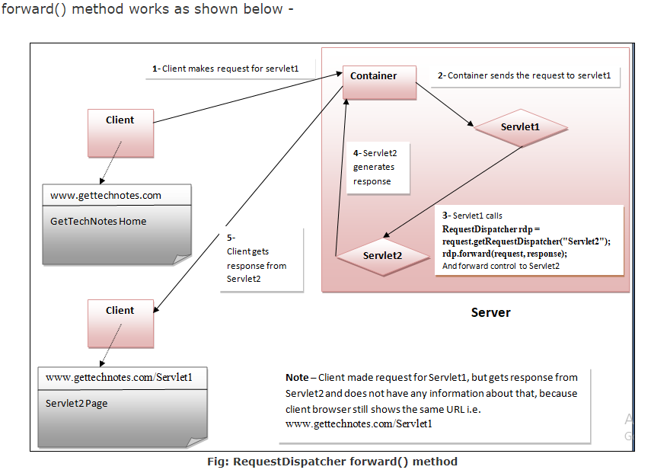

Slide 4
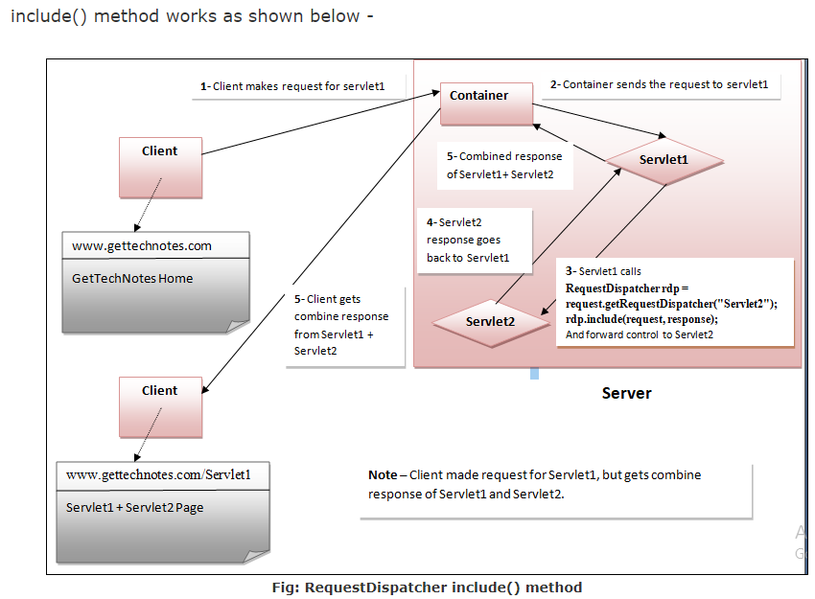

Slide 5
Example -
In this example, default page (index.html) will ask for username and password, if we enter correct username and password, it will forward us to Home page, otherwise it will again show you index.html page with an error message.
1- index.html or index.jsp - This will be default page.
<html>
<head>
<title>Login Form</title>
</head>
<body>
<form method="post" action="LoginCheck">
<table border="1px">
<tr>

Slide 6
<td>User Name: </td>
<td><input type="text" name="t1"></td>
</tr>
<tr>
<td>Password </td>
<td><input type="password" name="t2"></td>
</tr>
<tr>
<td><input type="submit" value="Login"></td>
<td><input type="reset" value="Reset"></td>
</tr>
</table>
</form>
</body>
</html>
This will create a login form with two fields Username and Password, When we click the Login button it will redirect us to LoginChek servlet.

Slide 7
2- LoginCheck servlet - Create a Package named "servs" and within "servs", create a Servlet named "LoginCheck".
LoginCheck servlet will get the username and password entered by user, and if user enters the valid username and password (username = admin and password = 123 in our example) then redirected to Home servlet, otherwise it include index.html in LoginCheck servlet.
package servs;
import java.io.*;
import javax.servlet.*;
import javax.servlet.http.*;
public class LoginCheck extends HttpServlet {
public void doPost(HttpServletRequest request, HttpServletResponse response)
throws ServletException, IOException {

Slide 8
try
{
PrintWriter out = response.getWriter();
String nm = request.getParameter("t1");
String ps = request.getParameter("t2");
if(nm.equals("admin") && ps.equals("123"))
{
RequestDispatcher rdp = request.getRequestDispatcher("Home");
rdp.forward(request, response);
}
else
{
out.println("<p style='color:red'>Wrong username or password</p>");
RequestDispatcher rdp = request.getRequestDispatcher("index.html");
rdp.include(request, response);
}
}
catch(Exception ex)
{
System.out.println(ex);
}
}
}

Slide 9
3- Home servlet within servs create servlet named "Home".
package servs;
import java.io.*;
import javax.servlet.*;
import javax.servlet.http.*;
public class Home extends HttpServlet {
public void doGet(HttpServletRequest request, HttpServletResponse response)
throws ServletException, IOException
{
try
{
PrintWriter out = response.getWriter();
out.println("<!DOCTYPE html>");
out.println("<html>");
out.println("<head>");
out.println("<title>Servlet Home</title>");
out.println("</head>");

Slide 10
out.println("<body>");
out.println("<h1>Weclome to Home</h1>");
out.println("</body>");
out.println("</html>");
}
catch(Exception ex)
{
System.out.println(ex);
}
}
}

Slide 11
4- web.xml - Add the follwing code to web.xml within web-app
<servlet>
<servlet-name>LoginCheck</servlet-name>
<servlet-class>servs.LoginCheck</servlet-class>
</servlet>
<servlet-mapping>
<servlet-name>LoginCheck</servlet-name>
<url-pattern>/LoginCheck</url-pattern>
</servlet-mapping>
<servlet>
<servlet-name>Home</servlet-name>
<servlet-class>servs.Home</servlet-class>
</servlet>
<servlet-mapping>
<servlet-name>Home</servlet-name>
<url-pattern>/Home</url-pattern>
</servlet-mapping>

Slide 12
HttpServletResponse sendRedirect() method:-
sendRedirect() method is used to redirect client request to some other servlet, jsp or html file. It has the following syntax -
public void sendRedirect(String resourceURL) throws IOException
Where
resourceURL - is the servlet, jsp or html file , where client request will be redirected.

Slide 13
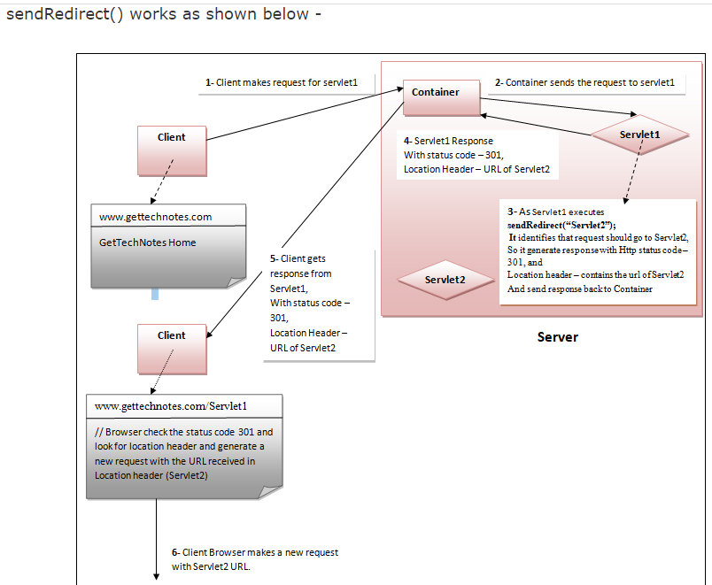

Slide 14
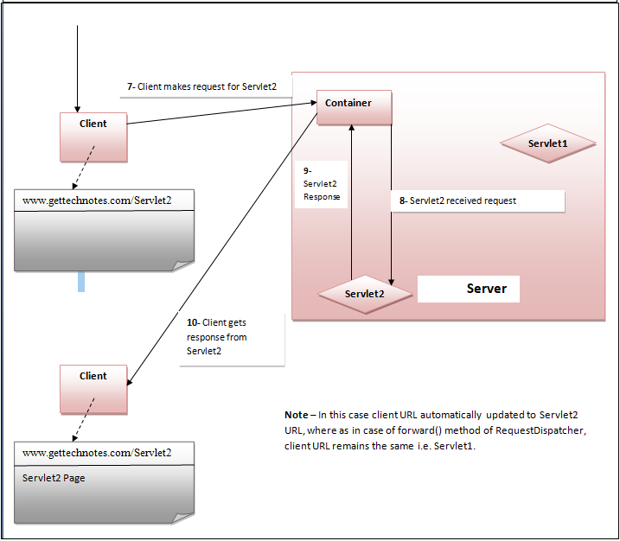

Slide 15
Example -
In this example, default page (index.html) will ask for username and password, if we enter correct username and password, it will redirect us to Home page, otherwise it will again show you index.html page with an error message.
1- index.html or index.jsp - This will be default page.
<html>
<head>
<title>Login Form</title>
</head>
<body>
<form method="post" action="LoginCheck">
<table border="1px">
<tr>
<td>User Name: </td>
<td><input type="text" name="t1"></td>
</tr>
<tr>
<td>Password </td>
<td><input type="password" name="t1"></td>
</tr>
<tr>
<td><input type="submit" value="Login"></td>
<td><input type="reset" value="Reset"></td>
</tr>
</table>
</form>
</body>
</html>

Slide 16
This will create a login form with two fields Username and Password, When we click the Login button it will redirect us to LoginChek servlet.
2- LoginCheck servlet - Create a Package named "servs" and within "servs", create a Servlet named "LoginCheck".
LoginCheck servlet will get the username and password entered by user, and if user enters the valid username and password (username = admin and password = 123 in our example) then redirected to Home servlet, otherwise it include index.html in LoginCheck servlet.
package servs;
import java.io.*;
import javax.servlet.*;
import javax.servlet.http.*;
public class LoginCheck extends HttpServlet {
public void doPost(HttpServletRequest request, HttpServletResponse response)
throws ServletException, IOException {

Slide 17
try
{
PrintWriter out = response.getWriter();
String nm = request.getParameter("t1");
String ps = request.getParameter("t2");
if(nm.equals("admin") && ps.equals("123"))
{
response.sendRedirect("Home");
}
else
{
out.println("<p style='color:red'>Wrong username or password</p>");
RequestDispatcher rdp = request.getRequestDispatcher("index.html");
rdp.include(request, response);
}
}
catch(Exception ex)
{
System.out.println(ex);
}
}
}

Slide 18
3- Home servlet Within servs create servlet named "Home".
package servs;
import java.io.*;
import javax.servlet.*;
import javax.servlet.http.*;
public class Home extends HttpServlet {
public void doGet(HttpServletRequest request, HttpServletResponse response)
throws ServletException, IOException
{
try
{
PrintWriter out = response.getWriter();
out.println("<!DOCTYPE html>");
out.println("<html>");
out.println("<head>");
out.println("<title>Servlet Home</title>");
out.println("</head>");
out.println("<body>");

Slide 19
out.println("<h1>Weclome to Home</h1>");
out.println("</body>");
out.println("</html>");
}
catch(Exception ex)
{
System.out.println(ex);
}
}
}

Slide 20
4- web.xml - Add the following code to web.xml within web-app
<servlet>
<servlet-name>LoginCheck</servlet-name>
<servlet-class>servs.LoginCheck</servlet-class>
</servlet>
<servlet-mapping>
<servlet-name>LoginCheck</servlet-name>
<url-pattern>/LoginCheck</url-pattern>
</servlet-mapping>
<servlet>
<servlet-name>Home</servlet-name>
<servlet-class>servs.Home</servlet-class>
</servlet>
<servlet-mapping>
<servlet-name>Home</servlet-name>
<url-pattern>/Home</url-pattern>
</servlet-mapping>

